Slide 1
ICT COE1105
Lecture 4
Introduction to Data communications and Computer Networking

Slide 2
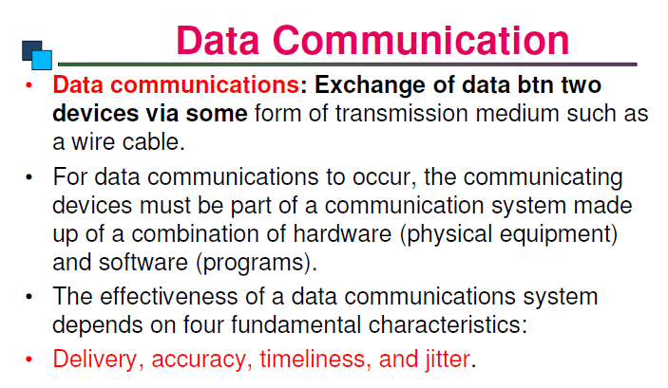

Slide 3
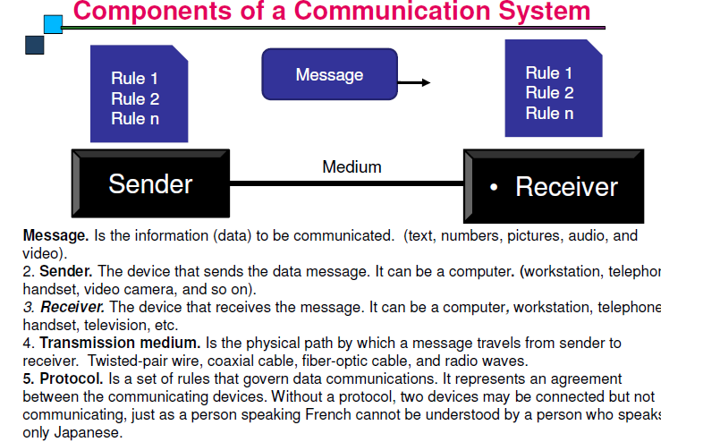

Slide 4
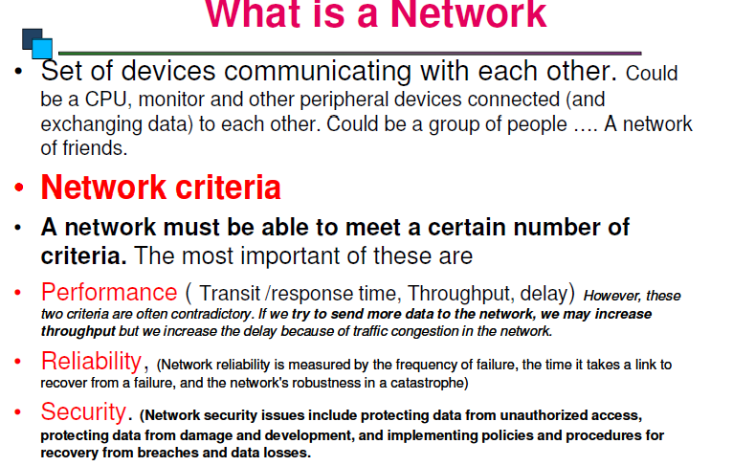

Slide 5
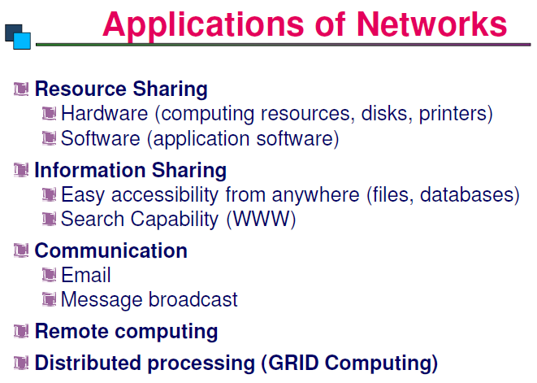

Slide 6
Three Modes of Data Transmission
Data is transmitted in one of three modes:
Simplex (Unidirectional transmission) is a single, one-way transmission.
Example: The signal sent from a TV station to your TV.
Half-duplex allows data to flow in one direction at a time.
Simultaneous transmission in two directions is not allowed.
Example: Two-way radios, police or emergency mobile radios
Full-duplex allows data to flow in both directions at the same time.
Bandwidth is measured in only one direction. 100 Mbps full-duplex means a bandwidth of 100 Mbps in each direction.
Broadband technologies, such as digital subscriber line (DSL) and cable, operate in full-duplex mode.

Slide 7
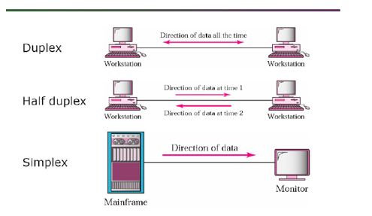

Slide 8
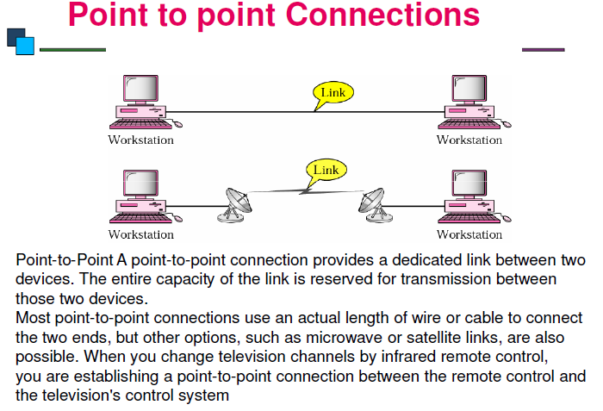

Slide 9
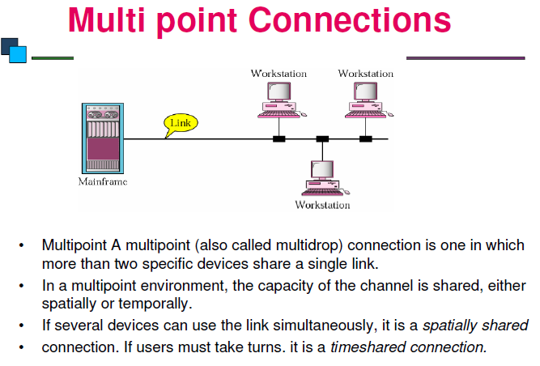

Slide 10
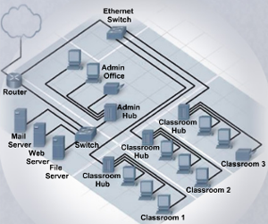
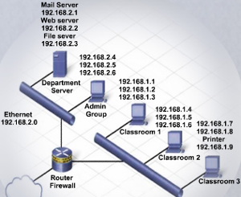
Two Types of LAN Topologies
Physical topology is the physical layout of the components on the network
Logical topology determines how the hosts access the medium to communicate across the network
Notes:
Slide 42 – LAN Topologies and Architectures
8.5 Describe LAN topologies and architectures
Topologies and architectures are building blocks for designing a computer network. A technician needs to understand how networks are designed in order to work on computers that are part of a network. There are two types of LAN topologies: physical and logical.
A physical topology is the physical layout of the components on the network.
A logical topology determines how the hosts communicate across a medium, such as a cable or the airwaves.
Topologies are commonly represented as network diagrams.
A LAN architecture is built around a topology. LAN architecture comprises all the components that make up the structure of a communications system. These components include the hardware, software, protocols, and sequence of operations.
After completing this section, students will meet these objectives:
Describe LAN topologies
Describe LAN architectures

Slide 11
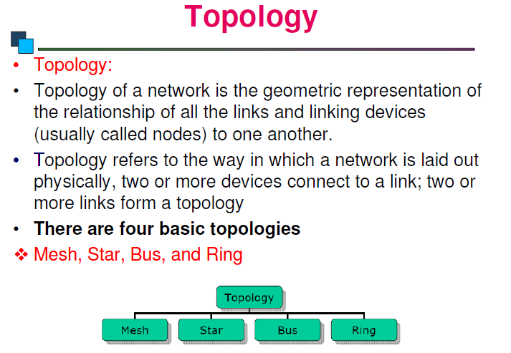
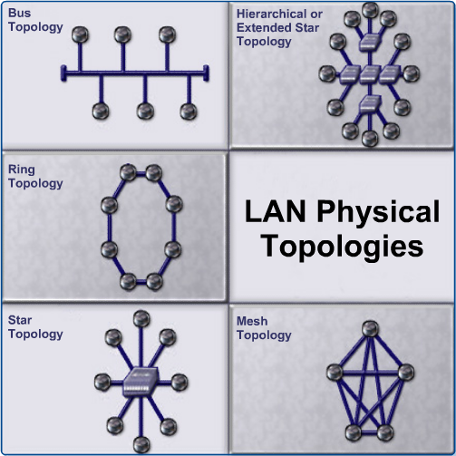

Slide 12
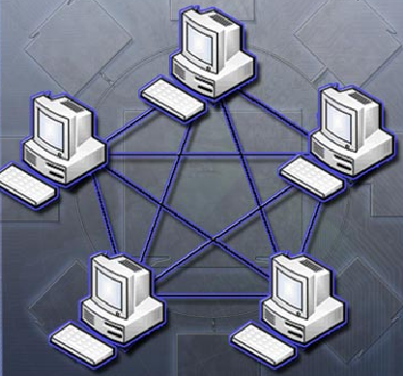
Mesh Topology
Connects all devices to each other
Failure of any cable will not affect the network
Used in WANs that interconnect LANs
Expensive and difficult to install because of the amount of cable needed
The Internet is an example of a mesh topology
Often used by governments when data must be available in the event of a partial network

Slide 13
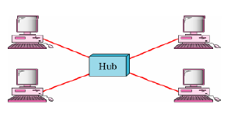
Star Topology
Has a central connection point: a hub, switch, or router
Hosts connect directly to the central point with a cable
Costs more to implement than the bus topology because more cable is used, and a central device is needed
Easy to troubleshoot, since each host is connected to the central device with its own wire.

Slide 14
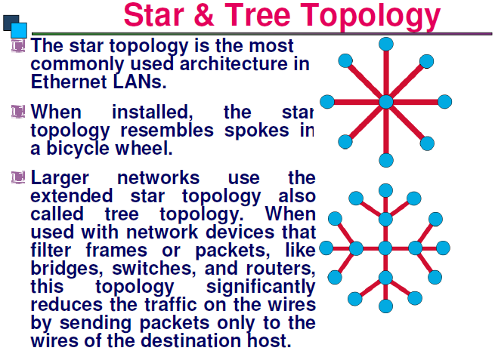

Slide 15
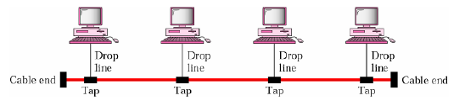
Bus Topology
Each computer connects to a common cable
Cable connects one computer to the next
Ends of the cable have a terminator installed to prevent signal reflections and network errors
Only one computer can transmit data at a time or frames will collide and be destroyed
Bus topology is rarely used today. Possibly suitable for a home office or small business with few hosts

Slide 16
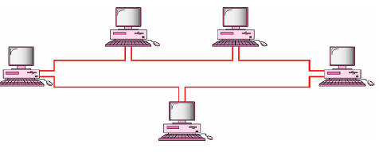
Ring Topology
Hosts are connected in a physical ring or circle.
The ring has no beginning or end, so the cable does not need to be terminated.
A special frame, a token, travels around the ring, stopping at each host.
The advantage of a ring topology is that there are no collisions.
There are two types of ring topologies:
Single-ring and Dual-ring

Slide 17
Internet
What is internet?
Internet A communication network that is itself a connection of many other networks
A Network can consist of two or more computers connected together by a medium such that they are able to share resources or information.
Resources include files, Printers, Hard-drives or CPU(Central Processing Unit).

Slide 18
The Web vs. The Internet
The World Wide Web (WWW): Is a collection of internet resources (such as FTP, telnet), hyperlinked text, audio, and video files, and remote sites that can be accessed and searched by browsers based on standards such as HTTP and TCP/IP.
It is part of the Internet
Hypertext Markup Language (HTML) is used to create Web pages
Hyperlinks connect Web pages to each other
Hypertext Transfer Protocol-HTTP
is a web’s application layer protocol
Internet
Massive network of networks.
Use various protocols such as
SMTP: Simple Mail Transfer Protocol
FTP:File Transfer Protocol

Slide 19
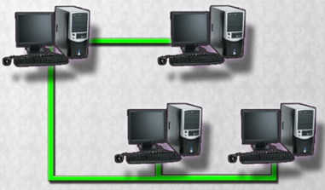
Peer-to-Peer Networking
Share files, send messages, and print to a shared printer.
Each computer has similar capabilities and responsibilities.
Each user decides which data and devices to share.
No central point of control in the network.
Best if there are ten or fewer computers.

Slide 20
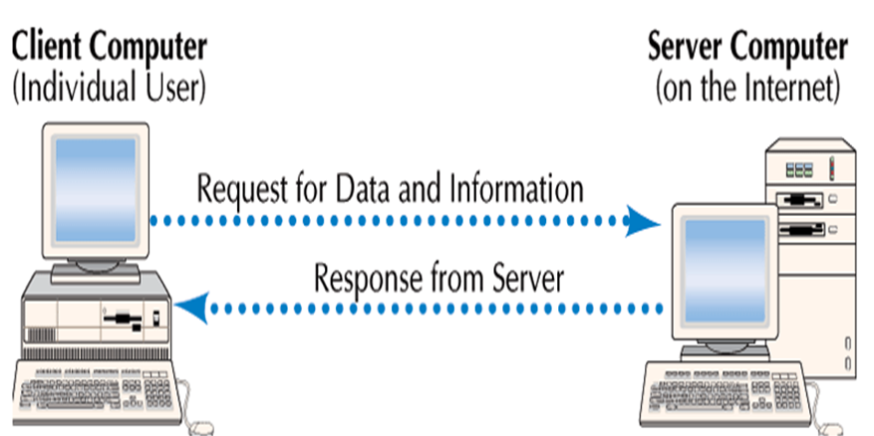
Client and Server
Client computer:
Users connect to the Internet
Request data and Web pages
Server computers
Store Web pages and data
Return the requested data to the client
Server
Client

Slide 21
IP address
Internet Protocol (IP) address: uniquely identifies a computer on the network.
It is a 32-bit binary number that is divided into 4 groups of 8 bits known as octets.
131.123.35.4. IP address can be either Dynamic/static

Slide 22
IP Address Configuration
Manual configuration
Manually configure each device with the proper IP address and subnet mask.
Dynamic configuration
A Dynamic Host Configuration Protocol (DHCP) server automatically assigns IP addresses to network hosts.
Network Interface Card (NIC) is the hardware that enables a computer to connect to a network and it has two addresses:
The IP address is a logical address that can be changed.
The Media Access Control (MAC) address is "burned-in" or permanently programmed into the NIC when manufactured. The MAC address cannot be changed.
Notes:
Slide 22 – IP Address Configuration
8.3.2 Describe IP addressing
Manual IP address configuration
In a network with a small number of hosts, it is easy to manually configure each device with the proper IP address.
A network administrator who understands IP addressing should assign the addresses and should know how to choose a valid address for a particular network.
To manually enter an IP address on a host, go to the TCP/IP settings in the Properties window for the Network Interface Card (NIC). The NIC is the hardware that enables a computer to connect to a network. It has an address called the Media Access Control (MAC) address. Whereas the IP address is a logical address that is defined by the network administrator, a MAC address is "burned-in" or permanently programmed into the NIC when it is manufactured. The IP address of a NIC can be changed, but the MAC address never changes.
The main difference between an IP address and a MAC address is that the MAC address is used to deliver frames on the LAN, while an IP address is used to transport frames outside the LAN. A frame is a data packet, along with address information added to the beginning and end of the packet before transmission over the network. Once a frame is delivered to the destination LAN, the MAC address is used to deliver the frame to the end host on that LAN.
Dynamic IP address configuration
If more than a few computers comprise the LAN, manually configuring IP addresses for every host on the network can be time-consuming and prone to errors. In this case, the use of a Dynamic Host Configuration Protocol (DHCP) server would automatically assign IP addresses and greatly simplify the addressing process.
Student Activity: The student course content includes worksheet, 8.3.2 Identify IP Address Classes. To complete this worksheet, students will specify the IP Address Class for each given IP address and mask.

Slide 23
Internet Protocols
A protocol is a set of rules.
Internet protocols are sets of rules governing communication within and between computers on a network.
Many protocols consist of a suite (or group) of protocols stacked in layers. These layers depend on the operation of the other layers in the suite to function properly.
The main functions of protocols:
Identifying errors
Compressing the data
Deciding how data is to be sent
Addressing data
Deciding how to announce sent and received data
Notes:
Slide 26 – Internet Protocols
8.3.4 Describe Internet protocols and applications
A protocol is a set of rules. Internet protocols are sets of rules governing communication within and between computers on a network. Protocol specifications define the format of the messages that are exchanged.
Timing is crucial to network operation. Protocols require messages to arrive within certain time intervals so that computers will not wait indefinitely for messages that may have been lost. Therefore, systems maintain one or more timers during transmission of data. Protocols also initiate alternative actions if the network does not meet the timing rules.
Many protocols consist of a suite of other protocols that are stacked in layers. These layers depend on the operation of the other layers in the suite to function properly.
These are the main functions of protocols:
Identifying errors
Compressing the data
Deciding how data is to be sent
Addressing data
Deciding how to announce sent and received data

Slide 24
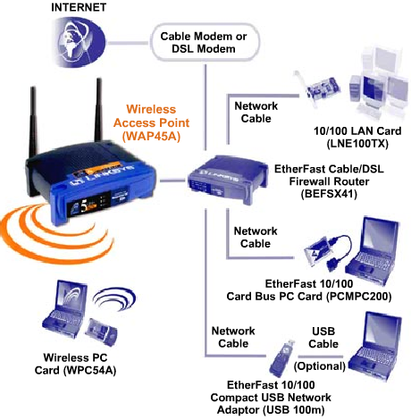
Physical Network Components
Network devices:
Computers
Hubs
Switches
Routers
Wireless access points
Network media:
Twisted-pair copper cabling
Fiber-optic cabling
Radio waves
Notes:
Slide 31 – Physical Network Components
8.4 Describe the physical components of a network
There are many devices that can be used in a network to provide connectivity. The device you use will depend on how many devices you are connecting, the type of connections that they use, and the speed at which the devices operate. These are the most common devices on a network:
Computers
Hubs
Switches
Routers
Wireless access points
The physical components of a network are needed to move data between these devices. The characteristics of the media determine where and how the components are used. These are the most common media used on networks:
Twisted-pair copper cabling
Fiber-optic cabling
Radio waves
After completing this section, students will meet these objectives:
Identify names, purposes, and characteristics of network devices
Identify names, purposes, and characteristics of the common network cables

Slide 25
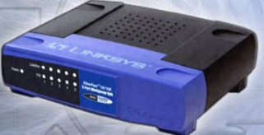
Hubs
Extend the range of a signal by receiving then regenerating it and sending it out all other ports
Traffic is sent out all ports of the hub
Allow a lot of collisions on the network segment and are often not a good solution
Also called concentrators because they serve as a central connection point for a LAN
Notes:
Slide 32 – Hubs
8.4.1 Identify names, purposes, and characteristics of network devices
To make data transmission more extensible and efficient than a simple peer-to-peer network, network designers use specialized network devices, such as hubs, switches, routers, and wireless access points, to send data between network devices. The type of connection that is needed determines the device that is used.
Hubs are devices that extend the range of a network by receiving a signal on one port, then regenerating the signal and sending it out to all other ports. This process means that all traffic from a device connected to the hub is sent to all the other devices connected to the hub every time the hub transmits data. This causes a great amount of network traffic. Hubs are also called concentrators, because they serve as a central connection point for a LAN.

Slide 26
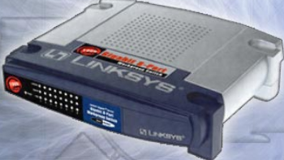
Bridges and Switches
A packet, along with its MAC address information, is called a frame.
LANs are often divided into sections called segments bounded by bridges.
A bridge has the intelligence to determine if an incoming frame is to be sent to a different segment, or dropped. A bridge has two ports.
A switch (multiport bridge) has several ports and refers to a table of MAC addresses to determine which port to use to forward the frame.
Notes:
Slide 33 – Bridges and Switches
8.4.1 Identify names, purposes, and characteristics of network devices
Files are broken up into small pieces of data, called packets, before they are transmitted over a network. This allows for error checking and easier retransmission if the packet is lost or corrupted. Address information is added to the beginning and to the end of packets before they are transmitted over the network. The packet, along with the address information, is called a frame.
LANs are often divided into sections called segments bounded by bridges.
A bridge has the intelligence to determine if an incoming frame is to be sent to a different segment, or dropped. This improves traffic flow of data by keeping frames from entering the wrong segment. A bridge has two ports.
Switches are sometimes called multiport bridges. A typical bridge may have just two ports, linking two segments of the same network. A switch has several ports, depending on how many network segments are to be linked. A switch is a more sophisticated device than a bridge. A switch maintains a table of the MAC addresses for computers that are connected to each port. When a frame arrives at a port, the switch compares the address information in the frame to its MAC address table. The switch then determines which port to use to forward the frame.

Slide 27
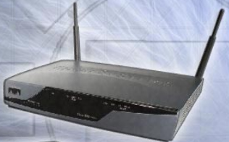
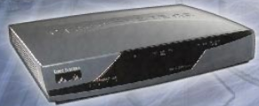
Routers
Routers are devices that connect entire networks to each other.
Use IP addresses to forward packets to other networks.
Can be a computer with special network software installed.
Can be a device built by network equipment manufacturers.
Contain tables of IP addresses along with optimal routes to other networks.
Notes:
Slide 34 – Routers
8.4.1 Identify names, purposes, and characteristics of network devices
While a switch connects segments of a network, routers are devices that connect entire networks to each other. Switches use MAC addresses to forward a frame within a single network. Routers use IP addresses to forward frames to other networks. A router can be a computer with special network software installed, or a router can be a device built by network equipment manufacturers. Routers contain tables of IP addresses along with optimal destination routes to other networks.

Slide 28

Wireless Access Points
Provide network access to wireless devices such as laptops and PDAs.
Use radio waves to communicate with radios in computers, PDAs, and other wireless access points.
Have limited range of coverage.
Notes:
Slide 35 – Wireless Access Points
8.4.1 Identify names, purposes, and characteristics of network devices
Wireless access points provide network access to wireless devices such as laptops and PDAs. The wireless access point uses radio waves to communicate with radios in computers, PDAs, and other wireless access points. An access point has limited range of coverage. Large networks require several access points to provide adequate wireless coverage.

Slide 29
Internet Service Provider
ISP (Internet service provider )
Internet service provider is a company that provides the connections and support to access the internet.
ISP can be National, regional or local companies
Choosing an ISP - Factors to consider:
Cost, Internet upgrades, Bandwidth and network capacity of ISP, Customer service, Reliability(How long has it been in business and how many satisfied clients do they have? ), Local access numbers,
E-mail options (Do you need more than one E-mail account?),Trial period
Notes:
Trial Period EarthLink ISP offers a trial of a reduced price per month for the first 6 months but then switches to normal pricing thereafter. This is not one of the best trial period offers out there.
Access Numbers Monster ISP has over 46,000 access numbers in the United States (46200 to be exact). This is very good when compared to other ISPs and is ideal for travelers. Note, however, that the company does not have coverage outside the continental USA.

Slide 30
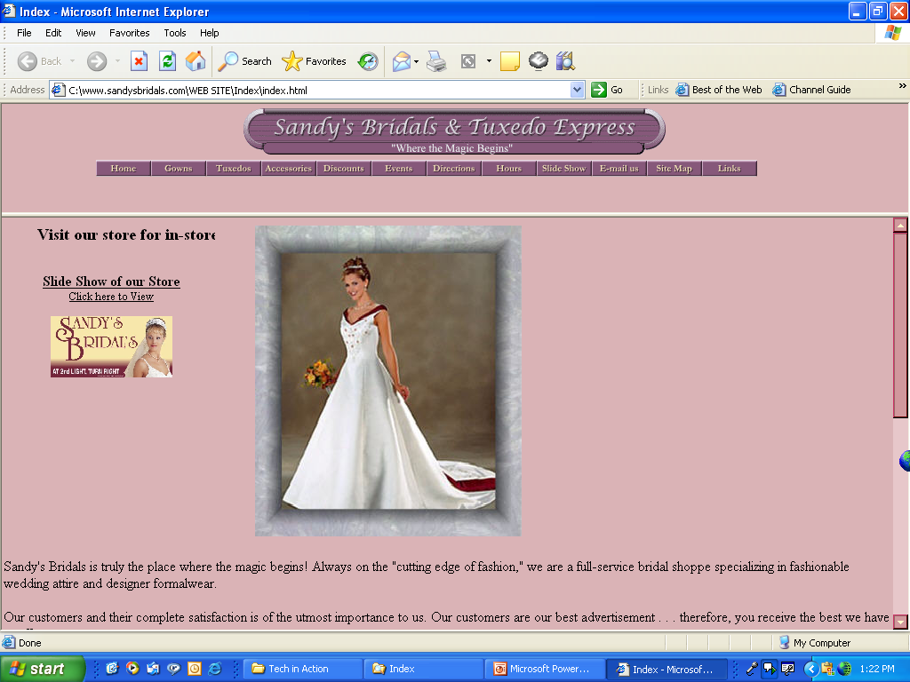
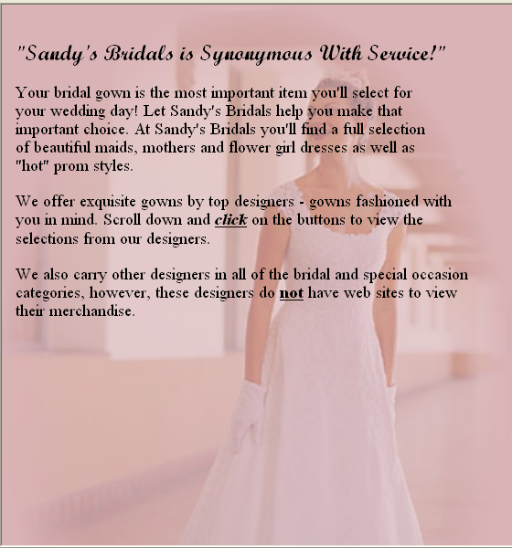
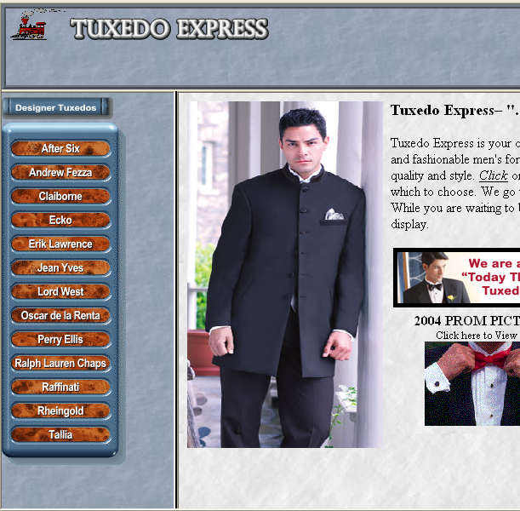
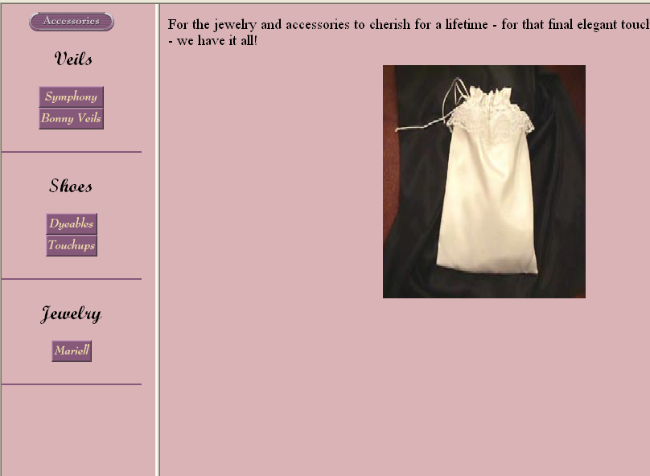
Web Sites
Web site:
Collection of related Web pages
First page known as Home or Index page
Web page:
HTML document
Text and graphics
Unique address
Hyperlinks
Home page
Related pages

Slide 31
URL
URL:
Uniform Resource Locator
Unique Web page address
HTTP: protocol from server to browser
Protocol identifies the means of access
Domain name contains the host and top-level domain
Path identifies the subdirectories within the Web site
URL
http://
www.nytimes.com/
Pages/cartoons/

Slide 32
Domains are groups of Computers on the same network and are a method to isolate communications between the members in the domain and the other data traffic.
.aero Members of the air transport industry
.biz Businesses
.com Can be used by anyone
.coop Cooperative associations
.edu Degree granting institutions
.gov United States government
.info Information service providers
.mil United States military
.museum Museums
.name Individuals
.net Networking organizations
.org Organizations (often nonprofits)
.pro Credentialed professionals

Slide 33
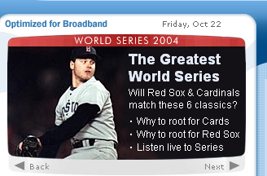

Hyperlinks
Provide access to other Web pages
Specially coded text or graphics
Cursor becomes a hand with finger pointing upward

Slide 34
Search Engines
Searches for keywords
Returns a list of Web pages
Popular search engines:
Google
Bing
Yahoo
Indexer
Spider
Search engine Software
www.metasearch.com

Slide 35
Internet search methods
Search methods are used by search tools to increase the effectiveness and efficiency of Internet searches.
Search methods:
Keyword
Field
Boolean
Miscellaneous

Slide 36
Types of data networks
Personal Area Network (PAN) Is a computer network used for communication among computer devices close to one person. Some examples of devices that may be used in a PAN are printers, fax machines, telephones, PDAs, or scanners.
Local Area Network (LAN) A network covering a small geographic area, like a home, office, or building. Current LANs are most likely to be based on Ethernet technology. For example, a library will have a LAN for users to connect to the internet.
Campus Area Networks (CAN) A network that connects two or more LANs but that is limited to a specific and contiguous geographical area such as a college campus, industrial complex, or a military base etc

Slide 37
Types of data networks cont’d
Metropolitan Area Network (MAN). Network is a network that connects two or more Local Area Networks or Campus Area Networks together but does not extend beyond the boundaries of the immediate town, city, or metropolitan area. Multiple routers, switches & hubs are connected to create a MAN.
Wide Area Network is a data communications network that covers a relatively broad geographic area (i.e. one city to another and one country to another country) and that often uses transmission facilities provided by common carriers, such as telephone companies.

Slide 38
Intranet – An intranet is a private LAN designed for use by everyone within an organization. An intranet might consist of an internal e-mail system, a message board and one or more Web site portals that contain company news, forms, and personnel information.
Access to an intranet’s web site is restricted by a firewall.
Extranet – a network that connects people within your company with people who are outside your company--all within a secure, password-protected network that can be accessed from anywhere.

Slide 39
Network channels Communications Channels
Communications Channel/Communications Medium: The physical or cableless media that link the different components of a network.
Physical channels – Physical channels are wires or cables along which data and information are transmitted. There are 3 types of physical channel: - Twisted pair
- Coaxial cable
- Optical cable

Slide 40
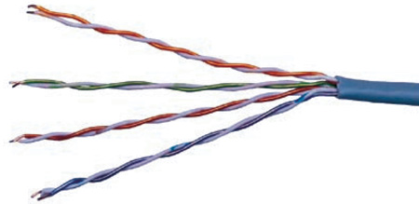
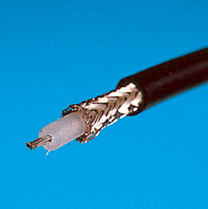
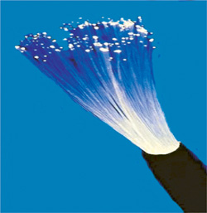
Physical communication channels
Twisted-pair wire: most prevalent form of communications wiring; consists of strands of copper wire twisted in pairs.
Coaxial cable: Insulated copper wire used to carry high-speed data traffic and television signals.
Fiber optics: Thin filaments of glass fibers that transmit information via light pulses generated by lasers.

Slide 41
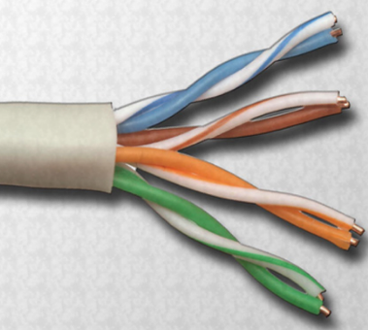
Twisted-Pair Cabling
A pair of twisted wires forms a circuit that transmits data.
The twisted wires provide protection against crosstalk (electrical noise) because of the cancellation effect.
Pairs of copper wires are encased in color-coded plastic insulation and twisted together.
An outer jacket, called poly-vinyl chloride (PVC), protects the bundles of twisted pairs.
Notes:
Slide 37 – Twisted-Pair Cabling
8.4.2 Identify names, purposes, and characteristics of common network cables
Until recently, cables were the only medium used to connect devices on networks. A wide variety of networking cables are available. Coaxial and twisted-pair cables use copper to transmit data. Fiber-optic cables use glass or plastic to transmit data. These cables differ in bandwidth, size, and cost. As a technician, you need to know what type of cable to use in different situations so that you are able to install the correct cables for the job. You will also need to be able to troubleshoot and repair problems that you encounter.
Twisted-pair is a type of copper cabling that is used for telephone communications and most Ethernet networks. A pair of wires forms a circuit that can transmit data. The pair is twisted to provide protection against crosstalk, which is the noise generated by adjacent pairs of wires in the cable. Pairs of copper wires are encased in color-coded plastic insulation and twisted together. An outer jacket protects the bundles of twisted pairs called poly-vinyl chloride (PVC). PVC will produce hazardous fumes when burned. Most network cables are installed in the plenum space, or areas in the ceiling, in the walls, and under the floor. If cables with the PVC jackets do burn in the plenum space, hazardous fumes can spread quickly through a building. To avoid this danger, only install plenum-grade fire resistant cabling in the plenum space.
When electricity flows through a copper wire, a magnetic field is created around the wire. A circuit has two wires, and in a circuit, the two wires have oppositely charged magnetic fields. When the two wires of the circuit are next to each other, the magnetic fields cancel each other out. This is called the cancellation effect. Without the cancellation effect, your network communications become slow due to the interference caused by the magnetic fields.

Slide 42
Two Basic Types of Twisted-Pair Cables
Unshielded twisted-pair (UTP)
Has two or four pairs of wires
Relies on the cancellation effect for reduction of interference caused by electromagnetic interface (EMI) and radio frequency interference (RFI)
Most commonly used cabling in networks
Has a range of 328 ft (100 meters)
Shielded twisted-pair (STP)
Each pair is wrapped in metallic foil to better shield the wires from electrical noise and then the four pairs of wires are then wrapped in an overall metallic braid or foil.
Reduces electrical noise from within the cable.
Reduces EMI and RFI from outside the cable.
Notes:
Slide 38 – Two Basic Types of Twisted-pair Cables
8.4.2 Identify names, purposes, and characteristics of common network cables
There are two basic types of twisted-pair cables:
Unshielded twisted-pair (UTP)
Has two or four pairs of wires
Relies on the cancellation effect for reduction of interference caused by electromagnetic interface (EMI) and radio frequency interference (RFI)
Most commonly used cabling in networks
Has a range of 328 ft (100 meters)
Shielded twisted-pair (STP)
Each pair is wrapped in metallic foil to better shield the wires from electrical noise. Four pairs of wires are then wrapped in an overall metallic braid or foil. STP reduces electrical noise from within the cable. It also reduces EMI and RFI from outside the cable.
Facts about STP
Prevents interference better than UTP.
Primarily used outside North America.
Disadvantages of STP
More expensive because of extra shielding.
More difficult to install because of the thickness.
Metallic shielding must be grounded at both ends. If not, shield acts like an antenna picking up unwanted signals.

Slide 43
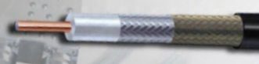
Coaxial Cable
A copper-cored network cable surrounded by a heavy shielding
Types of coaxial cable:
Thicknet or 10Base5 - Coax cable that was used in networks and operated at 10 megabits per second with a maximum length of 500 m
Thinnet or 10Base2 - Coax cable that was used in networks and operated at 10 megabits per second with a maximum length of 185 m
RG-59 - Most commonly used for cable television in the US
RG-6 - Higher quality cable than RG-59 with more bandwidth and less susceptibility to interference
Notes:
Slide 40 – Coaxial Cable
8.4.2 Identify names, purposes, and characteristics of the common network cables
Coaxial cable is a copper-cored cable surrounded by a heavy shielding. Coaxial cable is used to connect computers in a network.
There are several types of coaxial cable, including the following:
Thicknet or 10Base5 - Coax cable that was used in networks and operated at 10 megabits per second with a maximum length of 500 meters.
Thinnet or 10Base2 - Coax cable that was used in networks and operated at 10 megabits per second with a maximum length of 185 meters.
RG-59 - Most commonly used for cable television in the US
RG-6 - Higher quality cable than RG-59 with more bandwidth and less susceptibility to interference

Slide 44
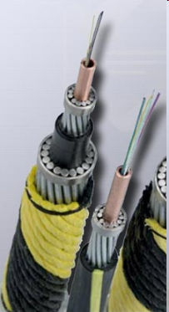
Fiber-Optic Cable
A glass or plastic strand that transmits information using light and is made up of one or more optical fibers enclosed together in a sheath or jacket.
Not affected by electromagnetic or radio frequency interference.
Signals are clearer, can go farther, and have greater bandwidth than with copper cable.
Usually more expensive than copper cabling and the connectors are more costly and harder to assemble.
Two types of glass fiber-optic cable:
Multimode and Single-mode
Notes:
Slide 41 – Fiber-Optic Cable
8.4.2 Identify names, purposes, and characteristics of common network cables
A glass or plastic strand that transmits information using light and is made up of one or more optical fibers enclosed together in a sheath or jacket.
Not affected by electromagnetic or radio frequency interference.
All signals are converted to light pulses to enter the cable, and converted back into electrical signals when they leave it.
Signals are clearer, can go farther, and have greater bandwidth than with copper cable.
Signal can travel several miles or kilometers before the signal needs to be regenerated.
Usually more expensive to use than copper cabling and the connectors are more costly and harder to assemble.
Common connectors for fiber-optic networks are SC, ST, and LC. These three types of fiber-optic connectors are half-duplex, which allows data to flow in only one direction. Therefore, two cables are needed.
Two types of glass fiber-optic cable:
Multimode - Cable that has a thicker core than single-mode cable. It is easier to make, can use simpler light sources (LEDs), and works well over distances of a few kilometers or less.
Single-mode - Cable that has a very thin core. It is harder to make, uses lasers as a light source, and can transmit signals dozens of kilometers with ease.

Slide 45
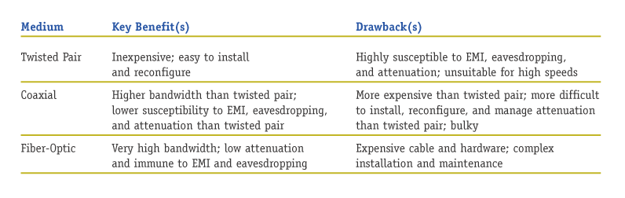
Physical communication channels

Slide 46
Capabilities of the Internet Three Main Functions
Communicate
Retrieve
Shop, Buy, and Sell

Slide 47
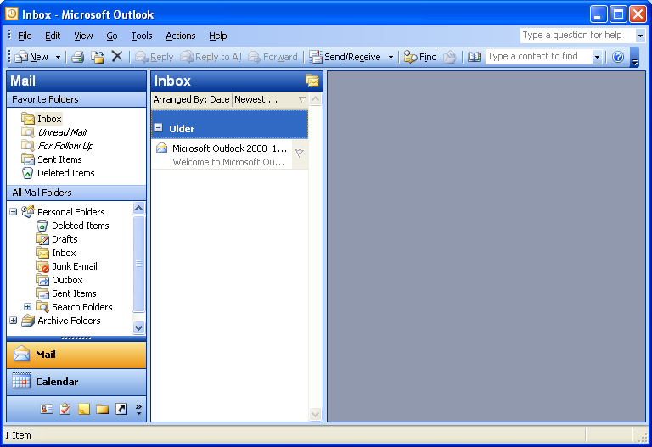
Capabilities of the Internet Communications Capabilities
E-mail or Electronic Mail: A service that transports text messages from a sender to one or more receivers via computer.
Primary means of communication
E-mail accounts
Client-based
Web-based
Spam
Prevention

Slide 48
What is spam?
Spam also known as junk e-mail refers to unsolicited message received in your inbox.
Junk e‑mail might include advertisements, fraudulent schemes, pornography, flyers, advertisements and catalogs or legitimate offers. Because it's very inexpensive for marketers to send junk e‑mail, it's not uncommon for people to receive a large amount of it.

Slide 49
Avoiding spam
Don’t volunteer to receive email
Don’t give email to anyone unless you know them
Don’t publish email on website
Keep multiple email addresses
Don’t respond to unsolicited email
Never ask to be removed from a spammer’s list
Never buy anything from spammer
Using a second email when posting newsgroups
Use spam filter
etc

Slide 50
Capabilities of the Internet Communications Capabilities
Mailing Lists: Each mailing list has subscribers who receive messages as part of an ongoing discussion of the list’s topic.
Moderated: A mailing list in which the messages are first screened by an individual to determine their suitability given the purpose of the list.
Newsgroups: Worldwide discussion areas where notices can be posted for anyone to view.

Slide 51
Capabilities of the Internet Shop, Buy, and Sell
Electronic Commerce/e-commerce: Conducting commercial activities on the Internet.

Slide 52
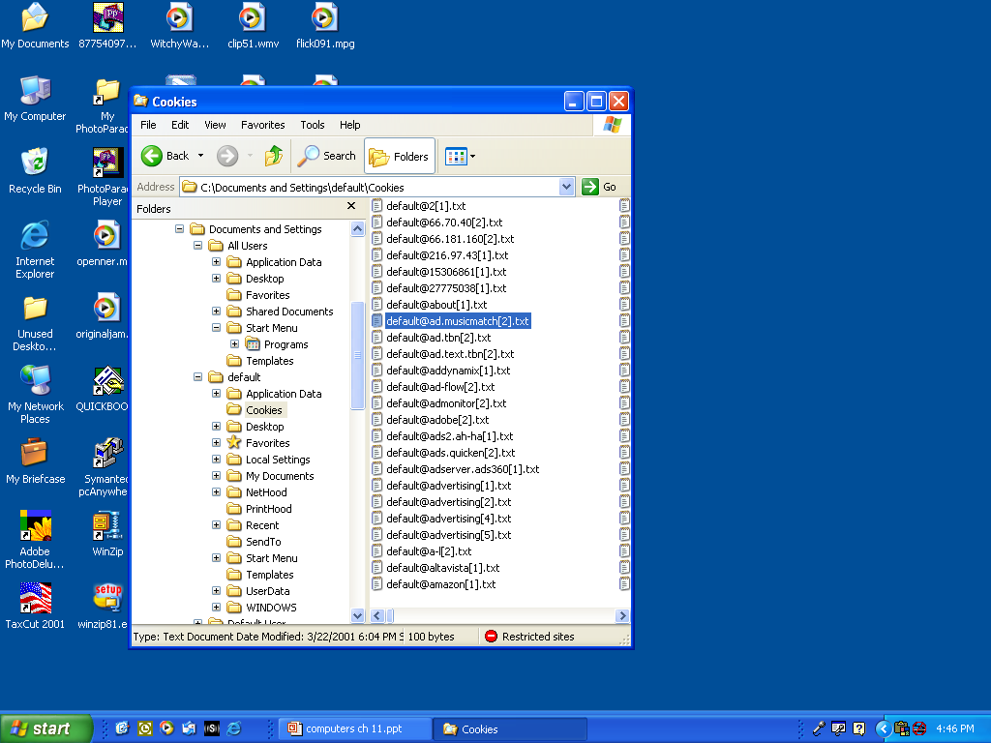
Cookies
Text files stored on client computers when visiting Web sites
Used on return visits to Web sites
Unique ID number
Personal information remembered
Privacy risk
Selling information

Slide 53
Web Entertainment
Multimedia:
Involves forms of media and text graphics, Audio, and Video.
Streaming audio and video
Plug-in
Games

Slide 54
What is a plug-in?
A plug-in is a set of software components that adds specific abilities to a larger software application.
If supported, plug-ins enable customizing the functionality of an application. Additional plug-ins can be downloaded from the Internet.
To add a plug-in, you must be logged on as an administrator.

Slide 55
Review Questions
Why is Internet referred to as a network of networks?
What is the origin of the Internet?
How does data travel on the Internet?
Differentiate between a static and dynamic IP address
What are my options for connecting to the Internet?
How do I choose an Internet service provider?
What is a Web browser?
What is a URL and what are its parts?
How can I use hyperlinks and other tools to get around the Web
Discuss internet crimes that are commonly committed by users over the internet and how they can be solved.

